Slide 1
World Trade Balance Visualization
Kenny Dao - Matthew Taylor – Jeremy Chia

Slide 2
The big question
How does the trade balance relate to economic activity during an expansion phase of the business cycle?

Slide 3
Hypothesis
In export-led growth countries (China, Singapore, Hong Kong and Vietnam), the trade balance will shift towards exports during an economic expansion.
In domestic demand-led growth (the US and Canada) the trade balance will shift towards imports at the same stage.

Slide 4
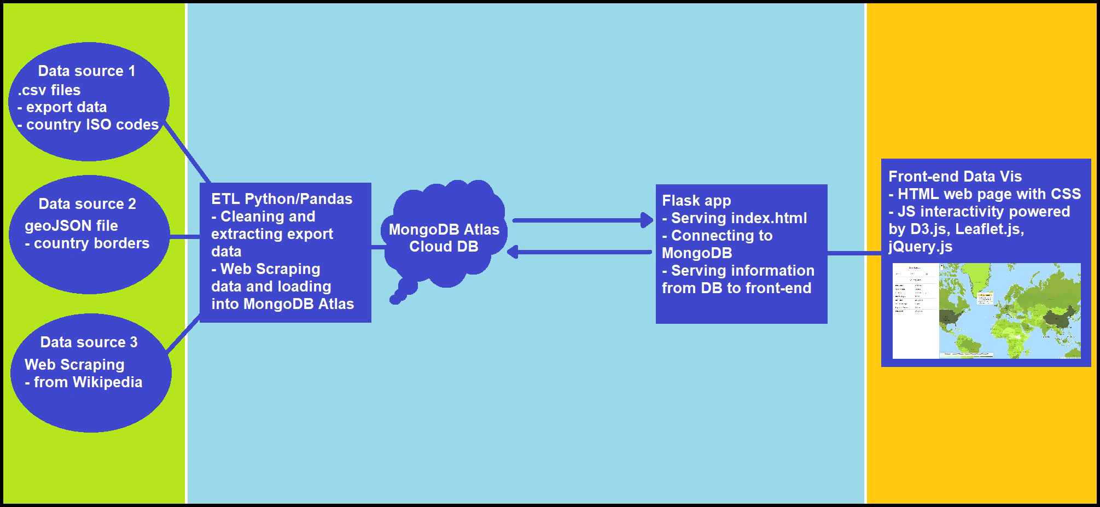

Slide 5
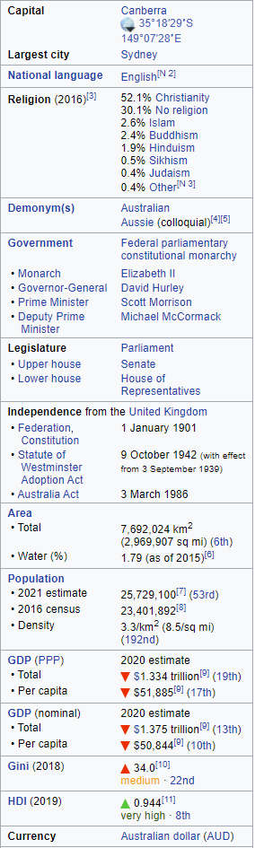
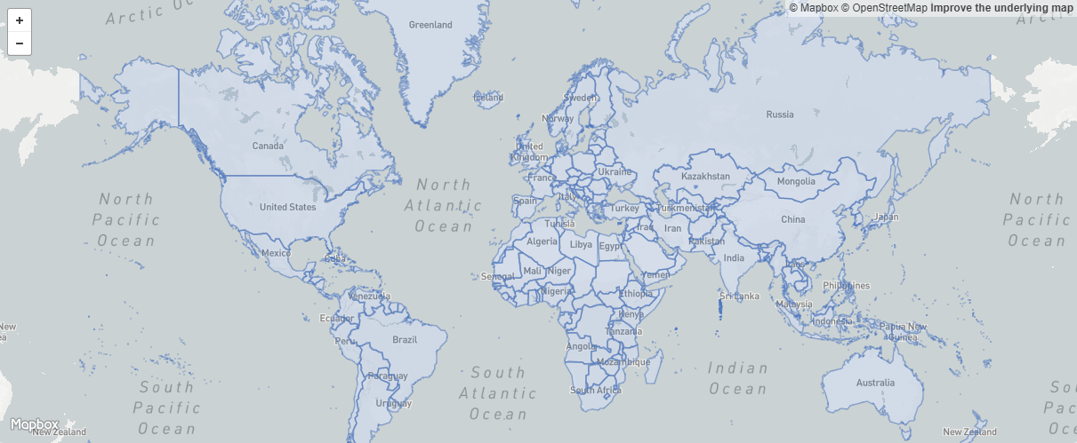
Data sources
International trade data: https://dataverse.harvard.edu/dataverse/atlas (csv)
Countries ISO codes: https://www.kaggle.com/juanumusic/countries-iso-codes
Country border geoJSON data: https://datahub.io/core/geo-countries#pandas
Countries information from Wikipedia: Web scrape - countries general information https://www.wikipedia.org/

Slide 6

ETL Python / Pandas
Data transformation – cleaning, merging extracting years and export data
Data loading – MongoDB Atlas Cloud Database

Slide 7
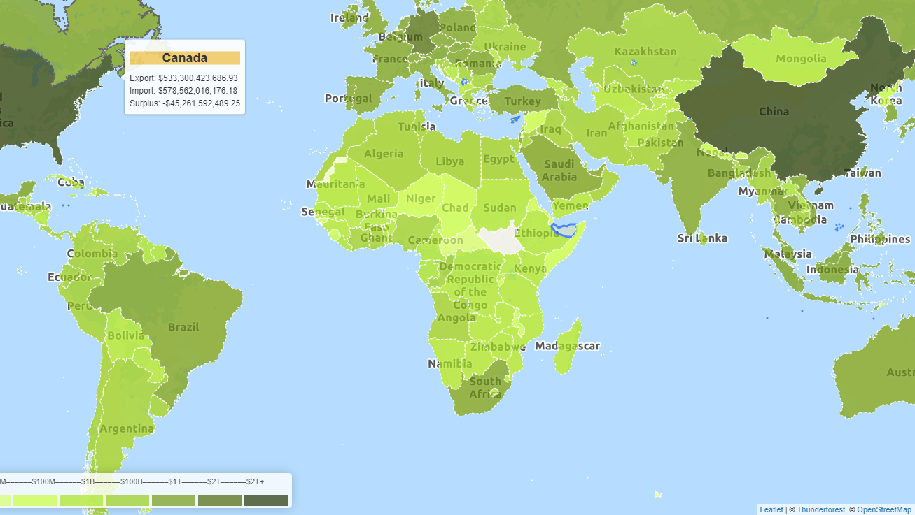
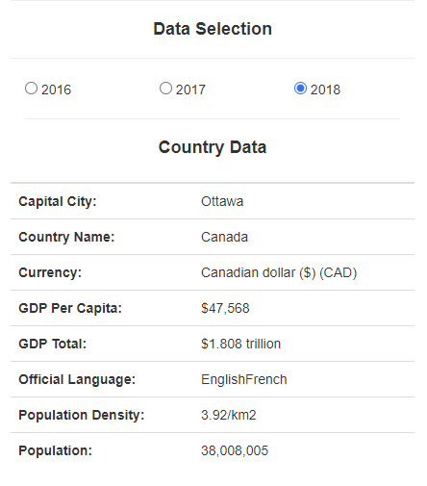
Flask app / Front End Data Viz
Serving index.html
Connecting to MongoDB
Serving information from MongoDB to front-end
HTML webpage with CSS
Javascript interactivity powered by D3.js, Leaflet.js, jQuery.js
Displays total export, import, net export value and contributions proportion of each country
When country is clicked on the map, information such as capital city, official language, population density, GDP total, GDP per capita and currency are displayed

Slide 8
Considerations for v2 of our project…
COVID-19’s impact on each country’s trade balances
COVID-19’s impact on global GDP
Visualising them!

Slide 9
Deployed to Heroku
https://world-trade-balance.herokuapp.com/
Check it out!!

